Slide 1
Deep Learning for Medical
소프트웨어학과 201920723 김동욱

Slide 2
Applications
Annotation
Classification
Detection / Localization
Segmentation
Registration
Regression
Image Reconstruction and Post-processing
Other tasks

Slide 3
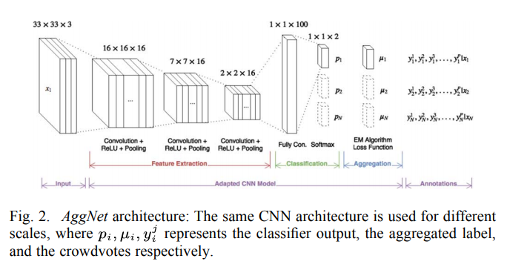
1) Annotation - model
AggNet
-CNN with Aggregation Layer, used crowdsourcing
-noise-resistant
-Detection in Breast Cancer

Slide 4
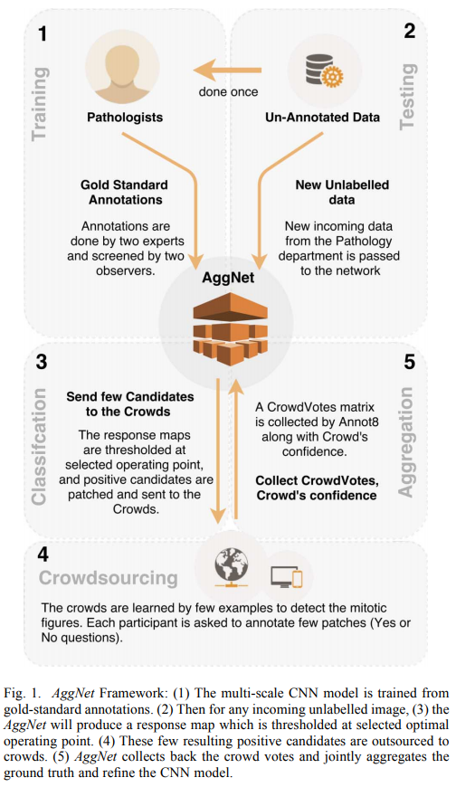
1) Annotation - training
1. Train multi-scale CNN with data labeled by pathologists.
2. Choose good response maps of unlabeled data and send them to crowds.
3. Get back the crowd annotations and refine the model

Slide 5

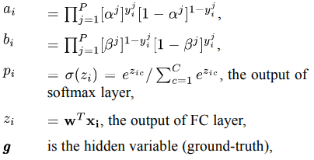

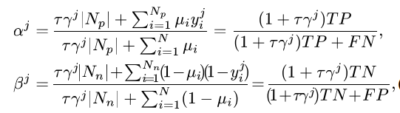

1) Annotation - loss

Slide 6
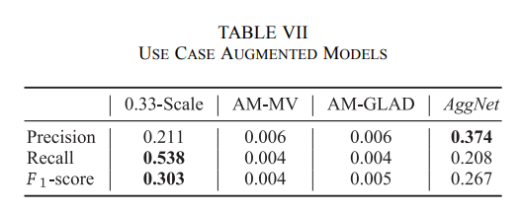
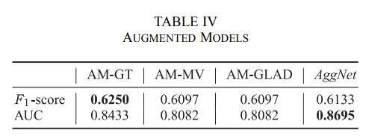
1) Annotation - conclusion

Slide 7
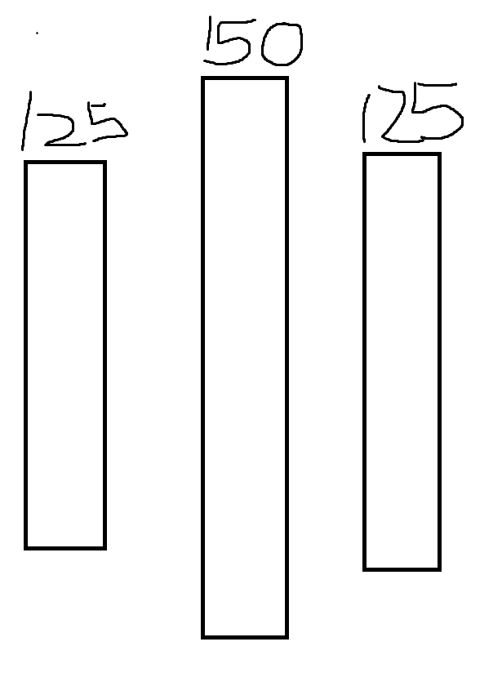
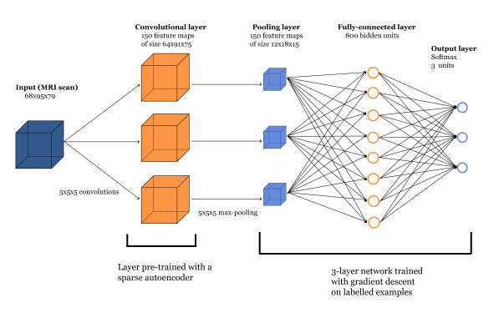
2) Classification - model
Used CNN pre-trained with sparse autoencoder

Slide 8


2) Classification - loss

Slide 9
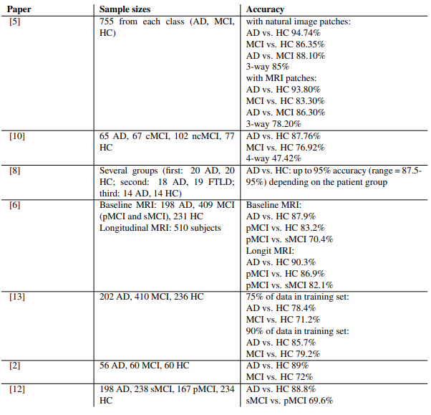
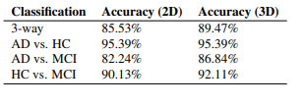
2) Classification - conclusion

Slide 10
papers
AggNet : https://ieeexplore.ieee.org/document/7405343
CNN with pre-trained filters with autoencoder : https://arxiv.org/pdf/1502.02506.pdf

